Slide 1
Washington Coast Marine Spatial Planning
Goal, Boundary and Objectives Setting Workshops
Day 1, March 29, 2013

Slide 2
Workshop Planning Team
Bridget Trosin, Washington Sea Grant
Steve Harbell, Washington Sea Grant
Jennifer Hennessey, WA Dept. of Ecology
Katrina Lassiter, WA Dept. of Natural Resources
Libby Whiting, WA Sea Grant Fellow- Dept. of Natural Resources
Kara Cardinal, WA Sea Grant Fellow- The Nature Conservancy

Slide 3
Workshop Participants
Coastal Treaty Tribes
Quileute
Quinault
Makah
Hoh
Washington Coastal
Marine Advisory Council
Coastal MRCs
Commercial Fishing
Recreational Fishing
Economic Development
Conservation
Ports
Energy
Education
Citizen
Science
Aquaculture
Shipping
Tourism
Federal Agencies
Olympic Coast National Marine Sanctuary
Olympic National Park
NOAA- National Marine Fisheries Service
U.S. Fish and Wildlife Service
NOAA- Office of Coastal Resource Management
U.S. Navy
U.S. Geological Service
U.S. Coast Guard
U.S. Army Corps of Engineers
Local Governments
Pacific County
Clallam County
Jefferson County
Grays Harbor County
City of Westport
City of Ocean Shores
State Agencies
WA Dept. of Ecology
WA Dept. of Natural Resources
WA Sea Grant
WA Dept. of Fish and Wildlife
WA State Parks
WA Dept. of Commerce
WA Dept. of Health
Notes:
Participants in the workshop are those who have jurisdictional authority over Washington resources or waters and those who have a vested interest in the future of the coast.

Slide 4
Small Group Activity:
What is your favorite sea creature?
Why am I here today? What’s in this for me?
What is the biggest challenge and opportunity in this process?
Notes:
Steve leads:
In small groups have them discuss the questions on the slide and select 3-4 people to report back to large group.

Slide 5
Washington coast MSP process for setting goals & objectives
Draft MSP Goal(s)/Objectives
Workshops – March-May
WCMAC
Review draft MSP Goal(s) & Objectives
Public Comment Period
Tribal consultations
State finalizes MSP Goals & Objectives
Adjust draft MSP Goal(s) & Objectives, as appropriate
Response to Comments
Governments: local, state, federal & tribal
Comments: May
Final: June 2013
Notes:
Jen talks about workshop outcomes and the objective setting process.
Steve asks the question “ Does this match up with why you are here? Is there anything else that you hoped to get out of this process?”

Slide 6
Workshop Outcomes
An identification of the priorities, interests, roles and expectations of key players
An understanding of marine spatial planning law and requirements, and the decision-making process for setting objectives
An identification of important social, economic, and ecological resources on the coast and threats to them
A discussion of participant’s desired future for the Washington Coast
An identification of a draft goal of WA MSP
An identification of a draft study area for WA MSP
An identification of draft objectives for WA MSP

Slide 7
Working Agreement
How will this group work together?
What will make this group successful?
Be respectful of others
Keep discussion brief and to the point
Don’t interrupt others
Keep an open mind- listen to the opinion of others
Avoid side conversations that distract others
Strive for consensus
Others?
Notes:
Steve asks” What would you change from the items listed ?” “What is missing from this list?”

Slide 8
Marine Spatial Planning
Overview
March 29, 2013
Jennifer Hennessey
Dept. of Ecology
Notes:
Goal: provide context for state law and process for marine spatial planning on Washington’s coast.

Slide 9
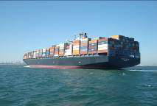
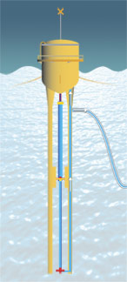
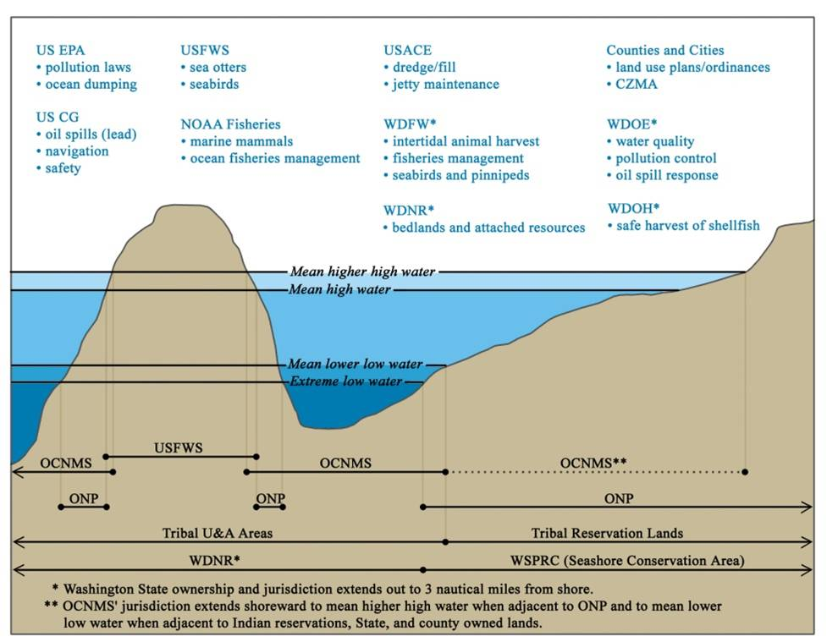
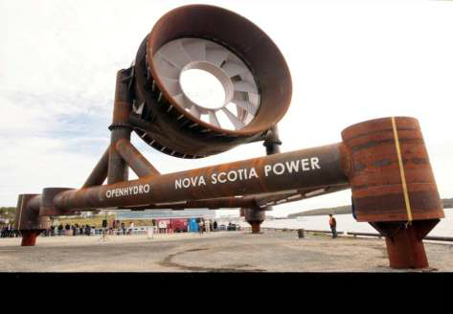
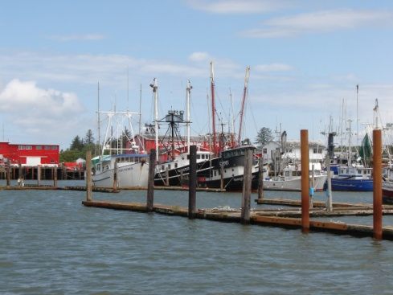
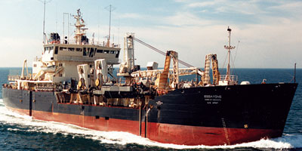
Why do we need planning?
New uses
Lots of governments and authorities!
Increasing pressures,
demands of existing uses
Conflicts among uses
Source: NOAA Olympic Coast National Marine Sanctuary
Hopper Dredge Essayons
Source: US Army Corps of Engineers
Notes:
Preserve and enhance public access
Planning provides a process to:
Balance the needs of society, environment and economy
Bring together information for decision-making
Proactively consider future and emerging issues

Slide 10
State Law Definition
State Law Definition
Marine Spatial Planning (MSP) is a public process of analyzing and allocating the spatial and temporal distribution of human activities in marine environments to achieve ecological, economic, and social objectives.
  Coordinating decisions – NON-regulatory
  Uses spatial data – often displayed as maps
  Proactive
  Multi-use
Notes:
Read definition from state law (see slide)
Simpler definition:
Marine spatial planning uses data on the location of important marine resources, human activities, and other key components to determine the most appropriate locations for particular marine uses. The planning process develops a shared vision, goals and objectives to guide the evaluation of all of this information, develop and assess management options, and create a plan. The plan will not make any final determinations about particular uses or projects, this will continue to be handled by the permitting process.
Why’s it different?
Marine spatial planning is a process for coordinating decisions for coastal and ocean activities and environments and, according to our law, is non-regulatory. That means it will rely on existing authorities to be implemented and will not create new regulations. Proactive, strategic and forward thinking –not- reactionary, permit by permit use. Streamlined approach to ocean management.
Why should you care?
Because planning processes are about developing a shared vision of our future for a place that is special, unique and important. It’s about the economic viability of our communities, the quality of life and the culture of our communities, and the sustainability of our shared natural resources. When things around us are changing, we need to do the best to use that opportunity to create the future we want. To do that right, we need the broad spectrum of our communities to get involved, come together and provide their perspectives on that future.
If time, additional information to potentially include:
What’s the result?
Typically, results in:
Vision
Comprehensive Plan
Management strategies and measures
Benefits include aligning management, improving efficiency and predictability of decisions.
Opportunity to steer in a way that fits us and to get federal resources for already identified priorities.
What does a plan look like?
Depends on the initial goals and objectives of the plan, which are determined through the planning process. Can vary widely depending on the scope of the plan. It’s NOT the same as zoning. The outcome depends on the scope of the plan and the mechanism for implementation.

Slide 11
State Law: Required plan elements
Ecosystem assessment and indicators
Management measures
Series of maps
State recommendations for federal waters
Implementation plan
Framework for renewable energy
Notes:
The state law requires several elements as part of a plan (read slide).

Slide 12
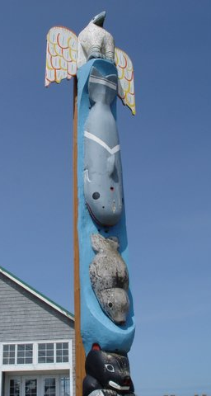
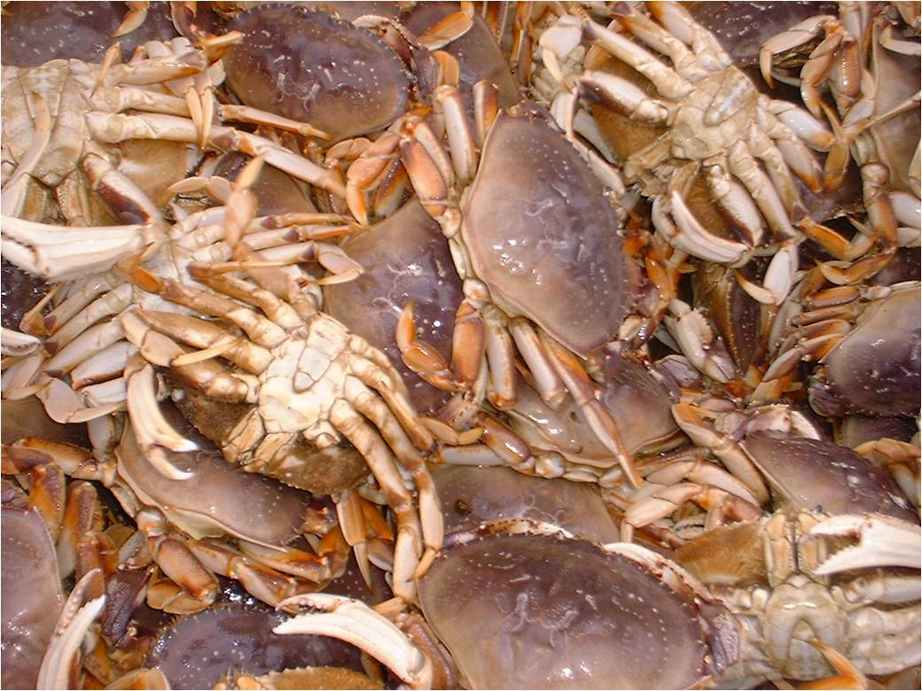
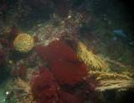
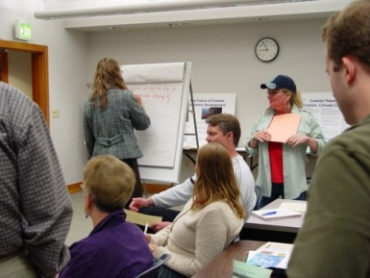
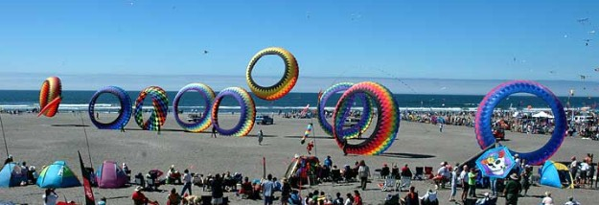

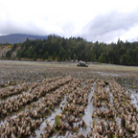
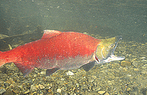
Core principles: content and process
Photo: Katie Lassiter
Photo:
Katie Lassiter
Notes:
The state law outlines several core principles that the plan must achieve both in content and process (point to principles poster). They are:
Respect tribal treaty rights
Recognize existing uses
Sustainable production of ecosystem goods/services
Impacts of climate change
Sustainable uses without significant adverse environmental impacts
Preserve and enhance public access
Protect and encourage working waterfronts and infrastructure and other water-dependent uses
Foster public participation
Integrate with existing management plans and authorities
Utilize best available science and adaptive management
These are common requirements from other state laws and regulations dealing with marine resources and will assist with integration and implementation of the plan through other authorities.

Slide 13
Planning is a Public Process
Coastal Marine
Advisory Council
Tribes
State agencies
Federal & Local Governments
Scientific Expertise
General Public
Notes:
Planning on the Washington’s Pacific Coast is a public process
The MSP law calls for an interagency team to coordinate the plan development (State Ocean Caucus – purple triangle) and Ecology is designated as lead coordinator for overseeing the planning process. Ecology also administers state’s coastal zone management program and is required to submit the final MSP plan to NOAA to be adopted into the state’s federally-approved coastal program. DNR is administering the funding for current MSP projects. Sea Grant is conducting outreach and getting scientific review of data and data gaps, and organizing these workshops to help us draft goals, objectives and a boundary for the plan. WDFW and State Parks have management roles and information and are also core members of the state team.
The Washington Coastal Marine Advisory Council (red triangle) is a diverse stakeholder body that advises the state on a variety of ocean policy issues, including marine spatial planning. It includes members from each of the coastal Marine Resource Committees as well as stakeholder interests such as fishing, ports, recreation, conservation, and energy.
In addition, tribal, federal and local governments will need to be involved and engaged in the process. We are also setting up ways to foster input from scientific experts as well as the general public.

Slide 14
What happens with the final plan?
Ecology submits to NOAA to be approved as part of state’s federally-approved coastal zone management program.
Improves application of Washington’s coastal program’s “enforceable policies” related to federal activities.
Other jurisdictions can use plan to inform their decisions.
Notes:
CZMA federal law that enables states to develop programs that are approved by NOAA. Federal consistency is a key tool in this law that a state can use to influence federal activities (either licensed, funded or taken by a federal agency). You’ll hear more in detail about this tool this afternoon.
Ocean Resources Management Act important policy on Washington’s coast because it provides broad guidance on criteria for allowing uses or activities in Washington’s coastal waters. For example avoiding and minimizing environmental, social and economic impacts. But it is hard to apply these criteria at the outset without an information framework that helps us understand where those impacts might be larger or smaller. (and inconsistently applied in local shoreline master programs).
State Environmental Policy Act - SEPA requires the compilation and evaluation of information on resources and impacts to the environment and humans of a particular project. The MSP can assist this process by gathering much of the needed best available science ahead of time. In addition, it will identify areas with sensitive resources or prone to conflicts. Therefore, the plan can direct applicants and projects to more viable areas from the outset and away from areas that would be difficult to permit.
Clean Water Act - An MSP can also improve application of the Clean Water Act (CWA). Washington Department of Ecology has delegated authority to implement the Clean Water Act in state waters. Both the CWA and Washington State water quality standards are designed for the protection of beneficial uses which includes ocean resources and human uses. Therefore, the MSP can help by identifying beneficial uses at a broader planning scale that would need to be protected through the required clean water permits for a particular project, such as a 401 water quality certification.

Slide 15
What’s the relationship between MSP and local Shoreline Programs?
MSP for SMP
SMP for MSP
Source of information and analysis on marine resources and uses.
Helps satisfy and meet ocean management criteria for coastal jurisdictions.
Source of policy recommendations.
An implementation mechanism for MSP.
Source of local knowledge, interests and information for MSP.
Improve federal consistency decisions.

Slide 16
Draft Process Timeline
Now – June 2013
Requires ongoing $
Stage 1: Pre- Planning Process |  |  |  |  | Stage 2: Understanding Impacts |  |  | Stage 3: Developing the Plan |  |  |  | Stage 4:
1. | 2. | 3. | 4. | 5. | 6. | 7. | 8. | 9. | 10. | 11. | 12. | 14.
Defining the study area vs. the management area | Defining management objectives | Identifying target resources for protection | Mapping uses of the marine environment | Understanding spatial, temporal and infrastructure requirements of each use | Identifying outside impacts | Predicting future uses | Identifying areas of conflict and compatibility | Selecting management strategies | Evaluating management strategies | Developing the spatial allocation plan | Submit MSP to NOAA for adoption into CZMA | IMPLEMENT AND EVALUATE MSP
Year 1 |  |  |  |  | Year 2 and 3 |  |  |  |  |  |  | Year 3 and Beyond
Similar to Phase 1 and Phase 2 of SMP process
Phase 2, 3 & 4 of SMP process
Phase 5 & 6 SMP
Notes:
So, right now, we are focused on pre-planning activities – ones that lay the foundation for a planning process. Those activities will not begin unless continued funding is available. If so, the more formal planning process will likely start sometime in 2013.

Slide 17
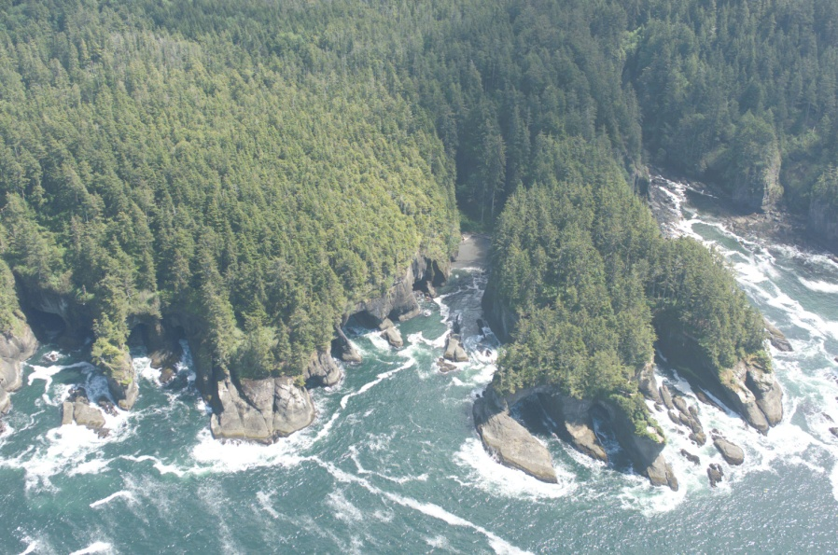
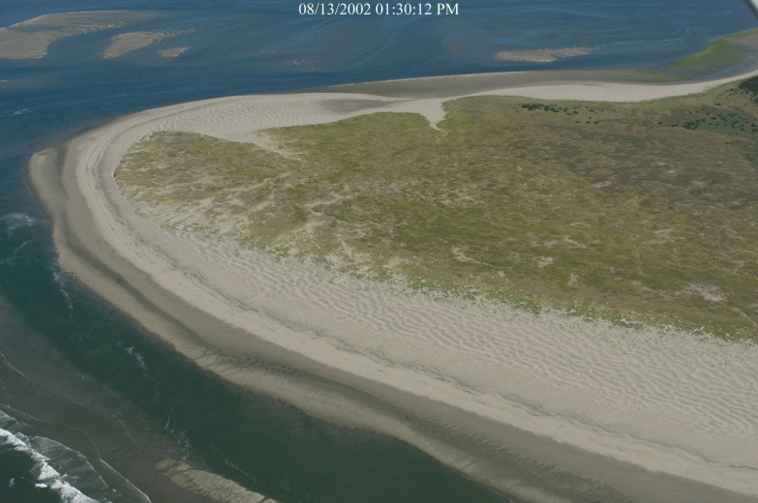
Sign up for an email list to get regular updates or check out more information at:
http://www.ecy.wa.gov/programs/sea/msp/
MSP lead coordinator:
Jennifer Hennessey
Dept. of Ecology
Jennifer.Hennessey@ecy.wa.gov
360-407-6595
MSP outreach:
Bridget Trosin
Washington Sea Grant
bemmett@uw.edu
206-616-6129
Notes:
Final Thoughts:
Planning for our ocean and our future makes sense for our economy, environment and society. Provides a process for considering and balancing our needs and values.
MSP can help resolve some important issues, but not all of them!

Slide 18
MSP Funding Overview
Katrina Lassiter
Dept. of Natural Resources

Slide 19
Planning Process - Budget Proviso
The department will work with the marine interagency team, tribes, and the Washington state marine resource committee to develop a spending plan
consistent with the priorities in chapter 252, Laws of 2012,
for conducting ecosystem assessments and mapping activities related to marine resources use and potential economic development,
developing marine management plans for the state's coastal waters, and
otherwise aiding in the implementation of marine planning in the state.
As appropriate, the team shall develop a competitive process for projects to be funded by the department in fiscal year 2013.

Slide 20
Planning Process to Date
Ongoing stakeholder outreach and workshops through Spring 2013
Goals and objectives
Human use mapping
Ecosystem Indicators
MRC outreach
Governor Gregoire signed SSB 6263, which made changes to the existing marine management planning law. The legislature also transferred $2.1 million into the Marine Resource Stewardship Acc’t.
The State met with the WCMAC, MRCs, and tribal staff to discuss and approve the draft working project list.
The State submitted a marine spatial planning report to the legislature.
Mar 2012
Aug 2012
May/June 2013
The State sought project ideas from the WCMAC, MRCs, tribes, and agencies
The WCMAC approved project categories for funding
The DNR has been preparing and executing marine spatial planning project contracts.
Notes:
Remove “re-cap”
What about putting this on a timeline? Make it more visual?
Add more recent update post-September

Slide 21
Planning Process for next biennium
State process for project selection in FY 13-15 biennium
WCMAC Project Review Sub-committee
Complete goals and objectives workshops and public comment period
Evaluate the data needed to complete a MSP that satisfies the goal and objectives
Compare data needs to existing and new data (from this year’s projects)
Identify data gaps and prioritize those areas for funding
Evaluate data and results from this year’s projects
Identify data gaps and data needs to meet goal and objectives
Provide recommendations to the WCMAC and the state on types of projects, funding levels, and scopes of work
*Tribal input will be solicited throughout the process

Slide 22
Sharing Your Vision for Washington’s Coast
Identify sources of ecological, social and economic wealth
Identify threats to ecological, social and economic wealth now and in the future
Describe your ideal vision for the coast. What is a healthy coastal community? What are your hopes for the future? What are the opportunities for the coast?
Notes:
Steve leads.
Break into small groups and report back to Steve and larger group.
Steve lumps information into themes.

Slide 23
MSP Objectives Topics
Contextual information | Planning principles | Core MSP objective topic
How things may change in the future regardless of the “plan”. E.g. climate change impacts. | Content or process required by law regardless of goals/objectives statements. | Central topic to address in plan.
How things are currently managed. E.g. fisheries, oil spills. |  | Central process outcome.

Slide 24
MSP Objectives Topics
Considerations
Is there a potential conflict between uses and/or needs?
Can the issue be resolved by managing activities or resources in time or space?
At what scale is the issue or problem occurring?
  Global
  Regional
  State
  Local
Do we have an existing process to manage the particular issue or problem?

Slide 25
Developing a Goal for MSP
Bridget Trosin
WA Sea Grant

Slide 26
Developing a Goal for Washington’s Marine Spatial Plan
Outcome: To develop 1 overarching goal for WA MSP
The goal will answer the question: “Marine spatial planning will contribute to ………..”
- a healthy marine ecosystem?
- a healthy economy?
-a sustainable future for the next generation?
Think big and broad

Slide 27
General outline of how a plan’s goal, objectives, and activities fit together
GOAL
Objective 1
Activity 1
Activity 2
Activity 3
Objective 2
Activity 1
Activity 2
Activity 3
Notes:
Goal- is a general summary of the desired state that a project is working to achieve.
Objective- is a specific statement of the desired outcome of a project.
Activity- Activities are specific actions or tasks designed to reach each of the projects objectives.

Slide 28
Examples from other state plans
Goal
Rhode Island
Foster a properly functioning ecosystem that is both ecologically sound and economically beneficial. Restore and maintain the ecological capacity, integrity, and resilience of the Ocean SAMP’s biophysical and socio-economic systems. Conduct research to better understand the current status of the natural resources, ecosystem conditions, and the implications of various human activities. Set standards within the SAMP document to protect and where possible restore and enhance natural resources and ensure that impacts from future activities are avoided and, if they are unavoidable, are minimized and mitigated so they are acceptable to the scientific community and the people of Rhode Island. Establish monitoring protocols to evaluate the consequences of decisions and adapt management to the monitoring results.
Notes:
Each state has a different way of organizing their goal and objectives.

Slide 29
Examples from other state plans continued
Oregon
Goal 19: Ocean Resources
“To conserve marine resources and ecological functions for the purpose of providing long-term ecological, economic, and social value and benefits to future generations.”
Goal 17: Coastal Shorelands
“To conserve, protect, where appropriate, develop and where appropriate restore the resources and benefits of all coastal shorelands, recognizing their value for protection and maintenance of water quality, fish and wildlife habitat, water-dependent uses, economic resources and recreation and aesthetics. The management of these shoreland areas shall be compatible with the characteristics of the adjacent coastal waters; and To reduce the hazard to human life and property, and the adverse effects upon water quality and fish and wildlife habitat, resulting from the use and enjoyment of Oregon’s coastal shorelands.”
Notes:
Two state wide planning goal directly relate to the Territorial Sea Plan in Oregon.

Slide 30
Goal Criteria
Visionary
Broad
Brief
Consistent with law
Consistent with state authorities
Notes:
Ask “What would you change or add to these criteria?”
Ask “ Do we have agreement that these are the criteria for our goal?”

Slide 31
Example Goal
“To maintain a healthy marine ecosystem on Washington’s Coast to provide marine-based economic and recreational opportunities for residents, visitors and future generations.”
What would you change? What would you keep?
Write your group’s goal on poster board
Notes:
Based on our conversation this morning I have created a broad goal statement. (read goal on slide)
We are now going to break into our small groups. Each small group will work from this statement and answer the question “ What would you change?” “ What do you keep?”
After your group has agreed, write your group’s goal on the poster board and we will share it with the larger group.

Slide 32
Considerations for Drafting the Washington Coast MSP Boundary
Kris Wall, NOAA-Office of Coastal Resource Management
Bill O’Beirne, NOAA- Office of Coastal Resource Management

Slide 33

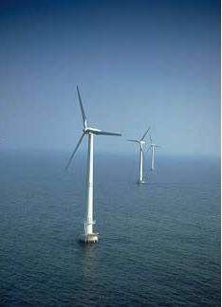
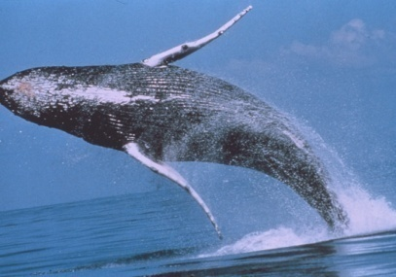
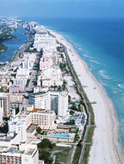
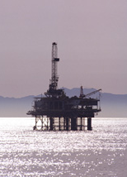
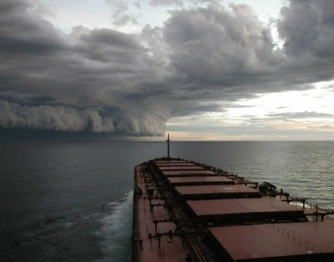
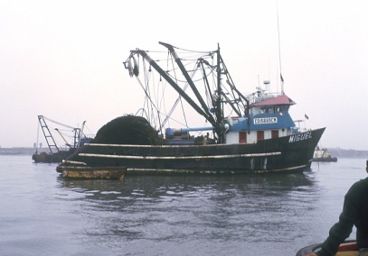
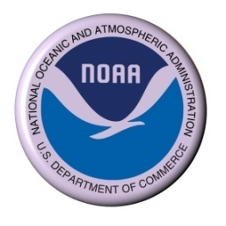
Federal Consistency under the CZMA
Office of Ocean and Coastal Resource Management
National Oceanic and Atmospheric Administration
http://coastalmanagement.noaa.gov/welcome.html
http://coastalmanagement.noaa.gov/consistency/welcome.html
Washington Marine Planning Workshop
March 29, 2013

Slide 34
Coastal Zone Management Act (CZMA)
Participation and Incentives
Administered by NOAA’s Office of Ocean and Coastal Resource Management (OCRM)
Voluntary
Two Incentives
  Federal Funding
  Federal Consistency
NOAA approval required
  Original State Programs
  Updates/Changes

Slide 35
The Coastal Zone Management Act: Federal Consistency Requirements
Powerful Tool for States
  Application of State Policies to Federal Actions
  No Geographical Boundaries (based on effects)
  No Categorical Exemptions
State-Federal Coordination
  Cooperation, Early Coordination, Negotiation
  Helps Federal Agencies and States to Address Coastal Effects
  States Concur with Approximately 95% of Reviewed Actions
Public Input
Avoids Costly Last Minute Changes to Federal Projects

Slide 36
What is Federal Consistency?
It’s An “Effects Test”
Federal Consistency is the requirement that Federal actions, in or outside the coastal zone, that affect any land or water use or natural resource of a State’s coastal zone must be consistent with the enforceable policies of State Coastal Management Programs.
(See CZMA Section 307 (16 U.S.C. § 1456))
Notes:
[CLICK] Information on the Appeal decisions.
See OCRM’s FC web site

Slide 37
“Federal Actions”
Federal Agency Activities & Development Projects CZMA 307(c)(1), (2), 15 CFR part 930, subpart C
Federal License or Permit Activities (non-federal applicants) CZMA 307(c)(3)(A), 15 CFR part 930, subpart D
Outer Continental Shelf Oil and Gas Plans CZMA 307(c)(3)(B), 15 CFR part 930, subpart E
Federal Financial Assistance to State or Local Agencies CZMA 307(d), 15 CFR part 930, subpart F

Slide 38
Coastal Effects
Federal Agency Activities
Federal Authorization Activities
Military Facilities
OCS Oil & Gas Plans
OCS Oil & Gas Leasing
Hydro-elec Licenses
Dredging
State
Coastal
Uses and
Resources
Gas Pipelines
Navigation Aids
Airport Layout Plans
Timber Sales
LNG Terminals
Land Disposal
ESA Permits
Fishery Plans
Wildlife Refuge Expansion
Wetland Alteration

Slide 39
Coastal Effects
Direct
Indirect
  Cumulative
  Secondary

Slide 40
Enforceable Policies
Legally binding under State Law
Approved by NOAA
  With input from Federal agencies and the public
Notes:
Apply to State Jurisdiction and not Federal areas or agencies
Not Preempted by Federal Law
Do not discriminate against a particular group or activity
Consistent with CZMA requirements
Once superseded by other State law, no longer enforceable
Provide a basic understanding of consistency and allow us to speak the same consistency language.
[CLICK] Make sure we all have the same set of tools.
[CLICK] Foster better communication.
[CLICK] Discuss consistency issues and answer some of your questions.
[CLICK] Start working out our issues together and help each other.
[CLICK] Maybe make a new friend or partnership.
[CLICK] Better coordinate and cooperate to meet our mutual and individual goals.
END

Slide 41
Scope of Consistency Effects Test:
Determining Geographic Scope
For Federal agency activities – effects test applies, regardless of location of activity (within CZ, outside CZ, other state).
Federal license or permit activities listed in a State’s CMP within CZ boundary are automatically subject to FC requirements.
Federal license or permit activities outside CZ boundary or in federal waters must be listed with a geographic location description (or may request a 1-time review unlisted activity)

Slide 42
Reviewing Federal License or Permit Activities Outside the Coastal Zone
15 C.F.R. § 930.53
OCRM approves state lists of federal license or permit activities subject to FC review
  To review listed activities outside CZ, state must provide a geographic location description (GLD) of such activities and show that there are reasonably foreseeable coastal effects from the listed activity within the GLD.
  Different listed activities may have different GLDs.
If no GLD approved by OCRM, state may request OCRM approval to review listed activities outside the CZ on a case-by-case basis as an unlisted activity. (15 C.F.R. § 930.54)

Slide 43
GLD Approval Based on Showing of Effects
Proposed GLDs must be geographically specific, apply to specific listed federal license or permit activities, and based on an analysis showing that effects on the state’s coastal uses or resources are reasonably foreseeable.
Effect analysis does not have to show proof of coastal effects, but must show a reasonable causal connection. The effects analysis cannot be based on conclusory statements.
A GLD does not need to delineate the boundary of where effects are reasonably foreseeable and where they are not; it only needs to be show that within the area described that effects are reasonably foreseeable.

Slide 44
CZMA 307(c)(3)(A) License or Permit Map
M.A.
R.I.
State Waters – Mass.
Other State – Subpart I
Inside Geo Loc – Listed
Effects Presumed – FC Applies
State Waters – Rhode Island
Inside CZ – Listed
Effects Presumed
FC Applies
Inside CZ – Unlisted
Effects NOT Presumed
State Needs NOAA Approval
STATE CZ BOUNDARY – 3 MILES
FEDERAL WATERS
Other State – Subpart I
Outside Geo Loc – Listed or Unlisted
Effects NOT Presumed
State Needs NOAA Approval
Outside CZ – Inside Geo Loc
Listed – Effects Presumed
FC Applies
Other State
NO Subpart I
NO FC Review
Outside CZ – Inside Geo Loc
Unlisted – Effects NOT Presumed
State Needs NOAA Approval
Geographic Location Boundary for R.I.
Outside CZ – Outside Geo Loc
Listed or Unlisted
Effects NOT Presumed
State Needs NOAA Approval
FEDERAL WATERS
All Reviews are if Rhode Island is Seeking Review
(Same scenario would apply on land)

Slide 45
Boundary Suggestions/Considerations
Consider which federal activities (licenses or permits) are mostly likely to have reasonably foreseeable coastal effects (that you would want to include in a GLD), and where those activities occur
Link to existing federal NEPA (EA, EIS) documents/studies and their defined geographic extent (and data availability) – provide causal information
Consider bathymetric features, ecologically critical areas (foraging, nursery), offshore migration patterns, etc.
Boundary must be defined based on fixed natural features, or lat/long coordinates
Consider geographic constraints/limits of certain activities or technologies (e.g. pipeline distances/costs, technology depths)
Where won’t things be, or won’t activities occur – exclude/ignore these areas.
Consider geographic extent of available spatial data that will be necessary for effects analysis

Slide 46
Effects Suggestions/Considerations
In general, the further from shore, the more difficult it can be to attest to coastal effects
Need to be able to attest to reasonably foreseeable coastal effects on state coastal resources or uses (not effects at the location in federal waters, but effects within the state coastal zone, or on state uses or resources)
Demonstration of coastal effects needs to be based on science and data – cannot be conclusory statements
Effect analysis does not have to show proof of coastal effects, but must show a reasonable causal connection (still a fairly high bar)
Consider migration patterns, foraging areas, breeding areas, areas of unique species abundance or concentrations
Don’t forget effects to uses as well as resources (e.g. fishing, recreation)

Slide 47
http://coastalmanagement.noaa.gov/consistency/welcome.html
OCRM National Interest Team
David Kaiser, Senior Policy Analyst
david.kaiser@noaa.gov -- 603-862-2719
Kerry Kehoe, Federal Consistency Specialist
kerry.kehoe@noaa.gov -- 301-563-1151
OCRM West Coast Team
Kris Wall, kris.wall@noaa.gov -- 503-231-2221 (Portland, OR)
Bill O’Beirne, bill.obeirne@noaa.gov – 301-563-1160 (HQ/Maryland)
    NOAA’s Office of Ocean and Coastal Resource Management

Slide 48
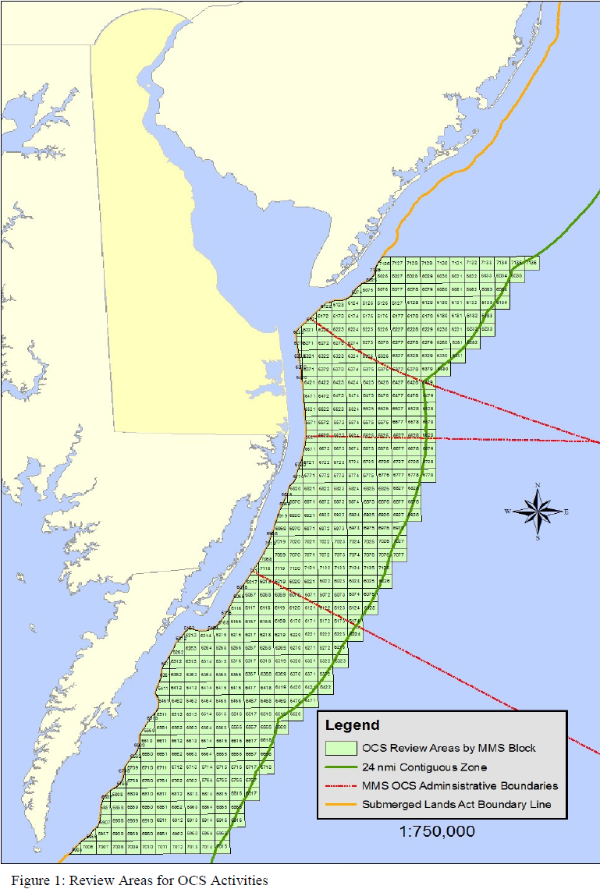
Delaware based its findings of coastal effects from offshore alternative energy projects on potential migration disruptions to avian species, acoustic and electromagnetic disturbances to marine species; the effects of exclusion zones on commercial and sport fishing; interference with electronic communications; and increased navigational risks due to the rerouting of vessel traffic.
Avian impacts reduced after challenge from BOEM.
Delaware’s final GLD for federal waters was reduced to the BOEM MD/VA boundary line as effects from alternative energy projects not reasonably foreseeable in federal waters off VA.
24 n.m. seaward boundary is based on the area of potential environmental effects described in the BOEM PEIS (2007) for its offshore alternative energy program.

Slide 49
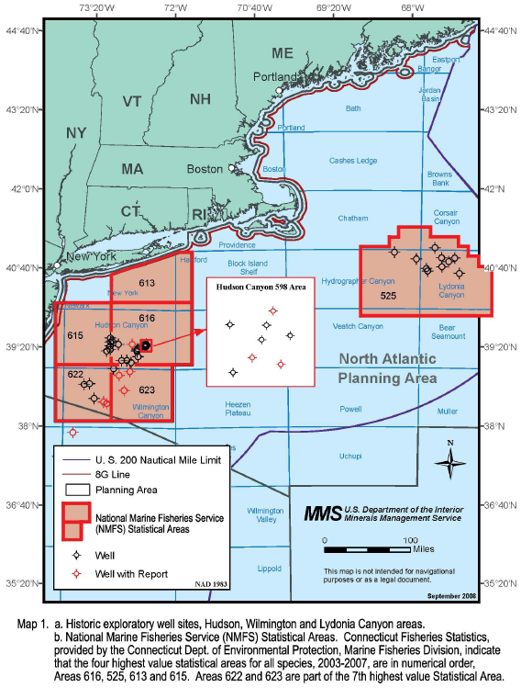
Connecticut initially proposed a much larger GLD for OCSLA offshore oil and gas Exploration Plans and Development and Production Plans authorized by BOEM – effects analysis not adequate.
The GLD was reduced to certain fishing areas based on NMFS statistical areas/data, which provided a reasonable basis for effects to commercial fishing in these areas from potential oil and gas development.

Slide 50
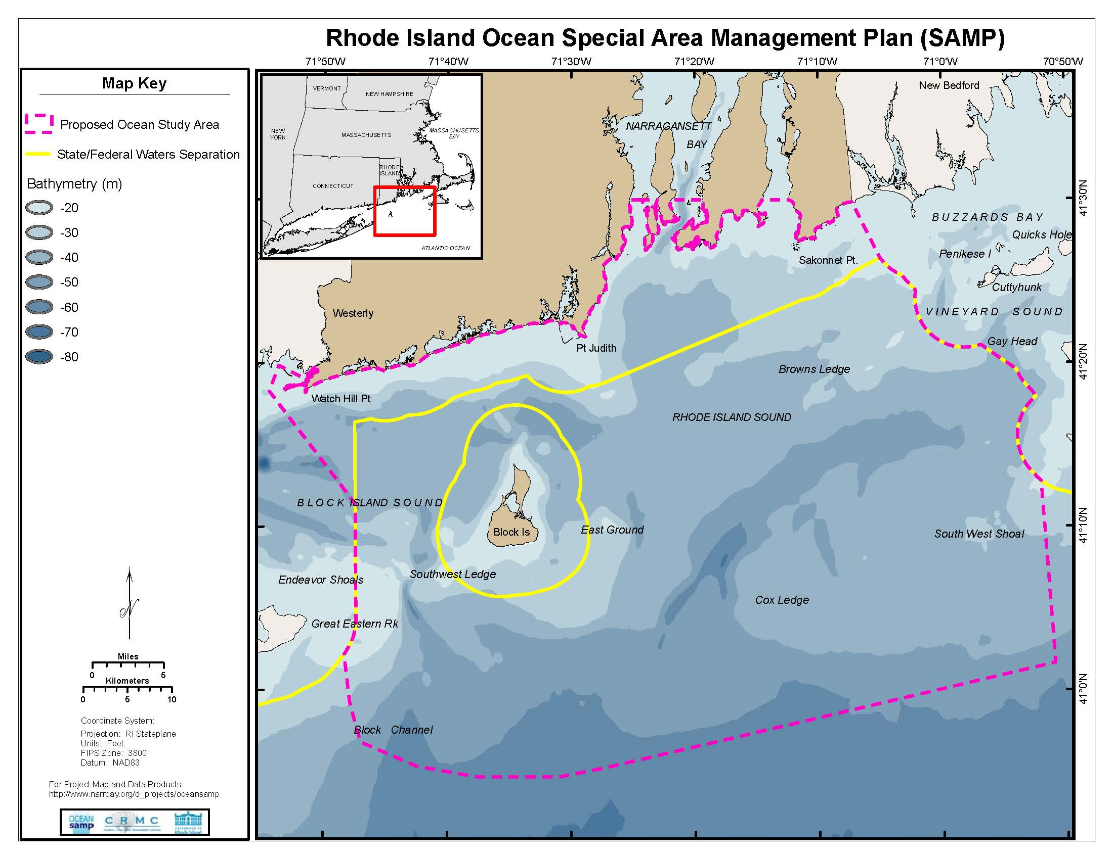

Slide 51
Boundary Considerations
What specific federal activities are expected? That most likely have reasonably foreseeable coastal effects (uses or resources)?
What are the geographic limits of those activities or technologies?
Ecological functions - bathymetric features, critical resource areas (e.g. habitats, feeding or breeding areas), or migration patterns.

Slide 52
Boundary Considerations
Amount of information and analysis needed – geographic coverage of existing studies and available spatial data (e.g. Environmental Impact Studies).

Slide 53
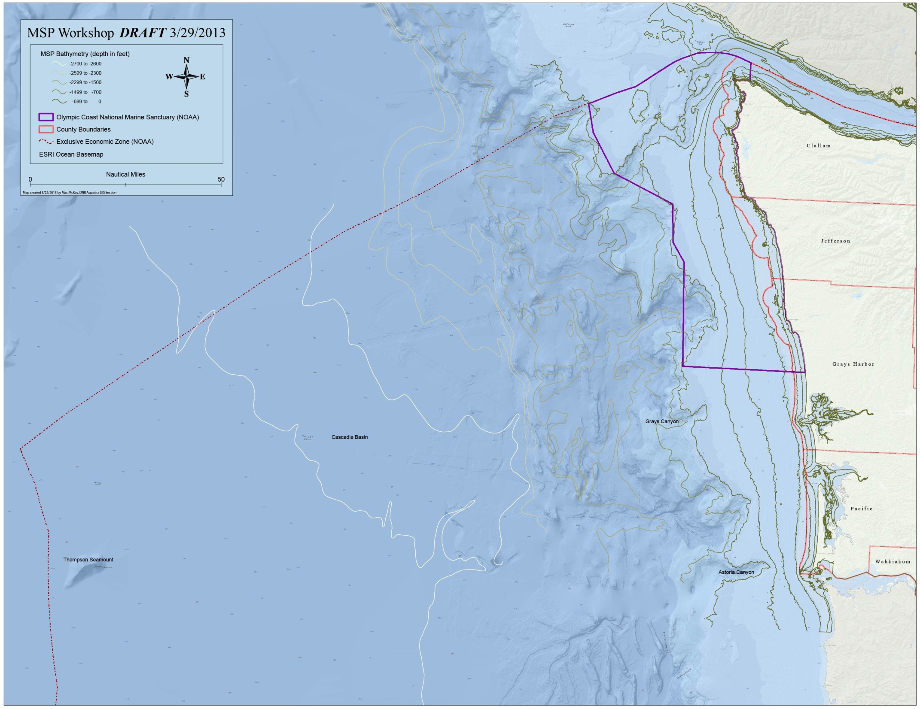

Slide 54
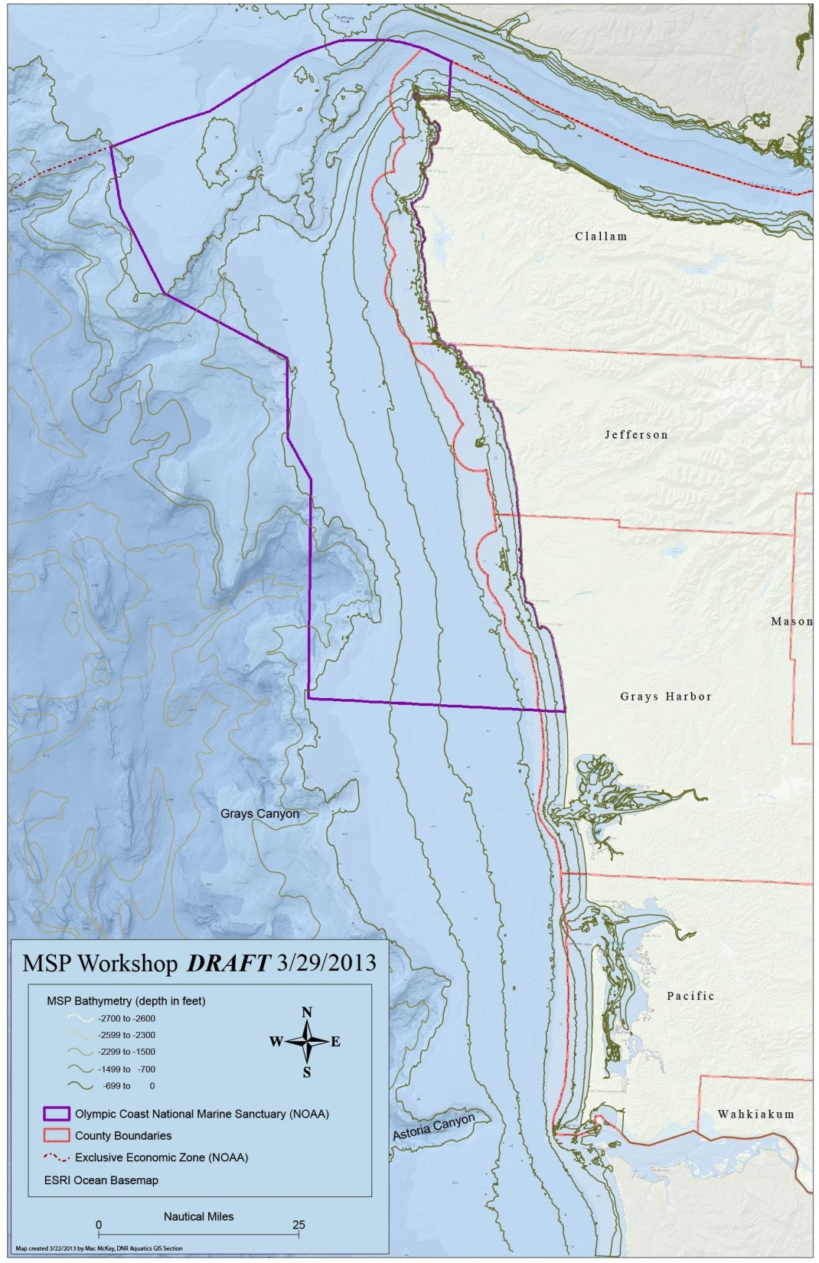

Slide 55
Next Steps
Drafting objectives on April 26th and May 3rd
Thank You!

